Slide 1
Development of MQTT Protocol-Based Client-Server System for IoT Applications in Nuclear Power Plants
INTERNSHIP
REVIEW 3
By
DHRUVA RAKESH B - 19BES7003
Under the Guidance of Sreejith Sasidharan
Internship is done at IGCAR, Kalpakkam

Slide 2
INTRODUCTION
Proper data management can provide insights into the equipment`s operation, usage, and condition, allowing for predictive maintenance and optimization.
By keeping track of data, equipment owners and operators can identify patterns that may indicate the need for repairs or replacements, preventing costly downtime and extending equipment lifespan.
Data storage and monitoring are especially important in industries requiring strict regulatory compliance.
By maintaining accurate records of equipment usage and performance, operators can ensure compliance with industry standards and regulations, avoiding fines or penalties.

Slide 3
MOTIVATION
To address this issue, the proposed project aims to develop a communication and data acquisition model that enables the communication and transfer of data wirelessly through the MQTT protocol.
The integration of an MQTT broker with an IoT platform would enhance accuracy and trust by ensuring that only authorized devices and users have access to the system.
This integration would also provide additional trust and knowledge features to the power plant, ensuring that sensitive data is protected and reliable.
In summary, the proposed project aims to develop a communication and data acquisition model that enables the communication and transfer of data wirelessly through the MQTT protocol.

Slide 4
IGCAR
Indira Gandhi Centre for Atomic Research [IGCAR], the second largest establishment of the Department of Atomic Energy next to Bhabha Atomic Research Centre, was set up at Kalpakkam [80 KMs south of Chennai], in 1971 with the main objective of conducting a broad-based multidisciplinary programme of scientific research and advanced Engineering, directed towards the development of sodium-cooled Fast Breeder Reactor [FBR] technology, in India. This is part of the second stage of the Indian Atomic Energy Programme, which is aimed at preparing the country for utilization of the extensive Thorium reserves and providing means to meet the large demands of electrical energy in the 21st century.

Slide 5
CONSTRAINTS
Safety Critical Application
Using only C / C++
Usage of only Linux based Systems
Limited resources
Complex IT Infrastructure

Slide 6
QT
QT is a cross-platform software development framework that is used to create desktop, mobile, and embedded applications. It is written in C++ and provides a range of tools and libraries for building applications that run on a variety of platforms, including Windows, macOS, Linux, Android, and iOS.
One of the key features of QT is its ability to provide a consistent user interface across multiple platforms. This is achieved through the use of QT's own widget toolkit, which provides a range of graphical user interface (GUI) components such as buttons, text boxes, and sliders. These components are designed to look and behave the same across all supported platforms, making it easy for developers to create applications that work seamlessly on different devices and operating systems.

Slide 7
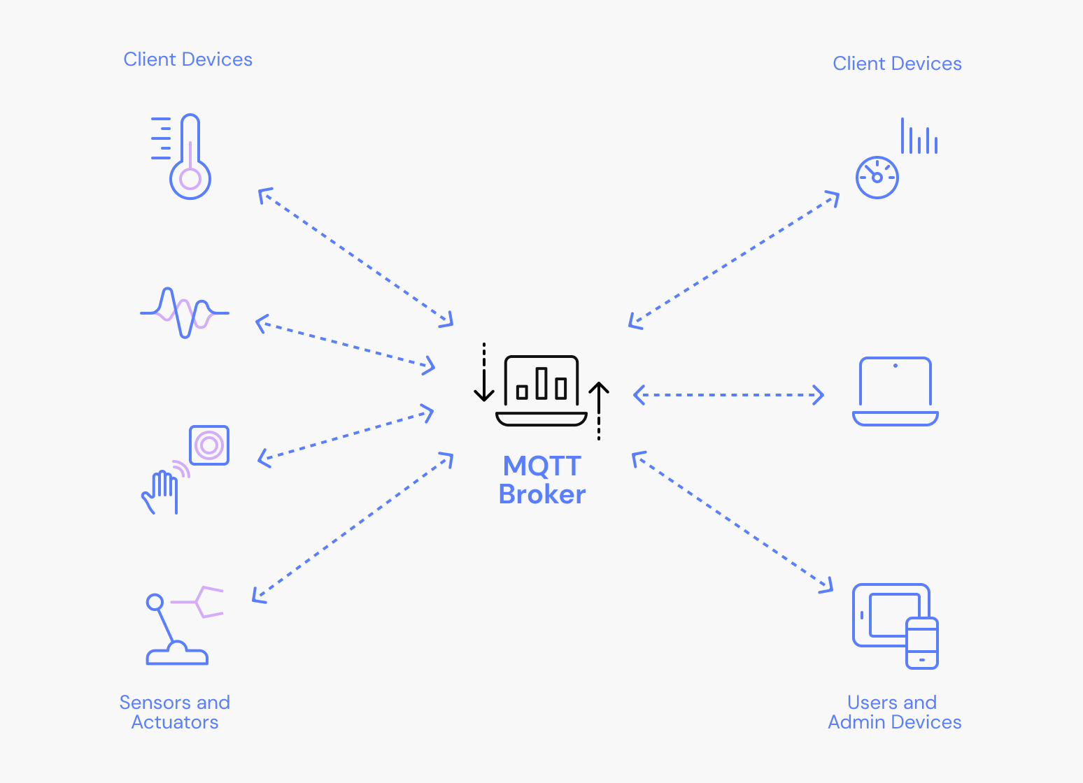
METHODOLOGY
To achieve the goal of our project we initially started with establishing a TCP communication with an open-source tcp server and designing a client in the Arduino.
Later we studied and observed and understood how a MQTT protocol works and studied the working of a broker then with the help of QT a cross-platform software development framework we designed and developed the MQTT broker and also developed a client for testing.

Slide 8
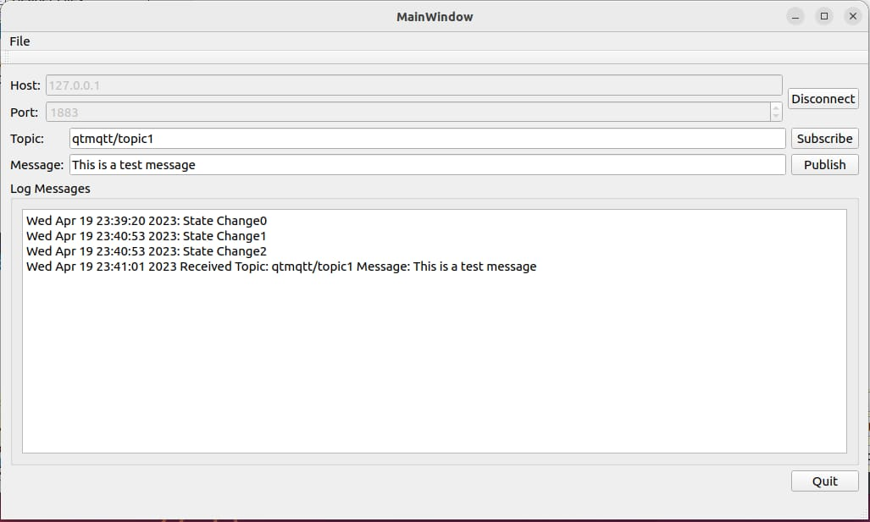
RESULTS
Simple MQTT Client demonstrates how to create a minimalistic client application. The Simple MQTT Client is a sample application of the MQTT client with minimal features. The Simple MQTT Client is typically used for testing and development purposes.

Slide 9
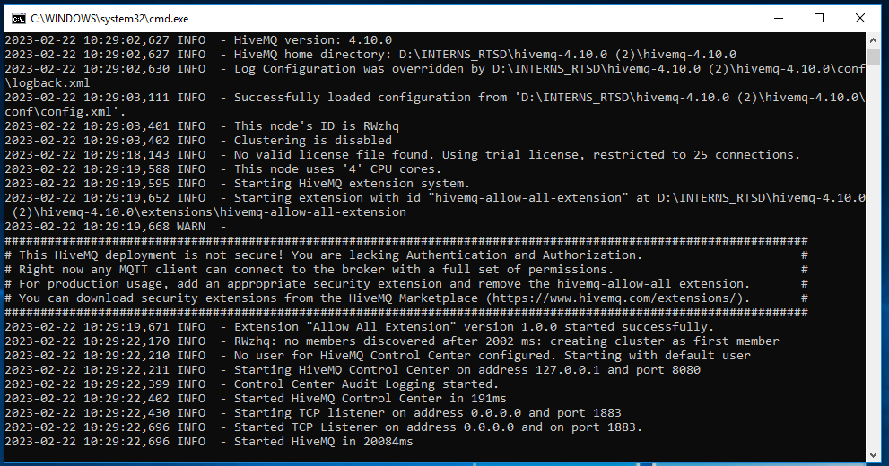
RESULTS
HiveMQ broker running in the background

Slide 10
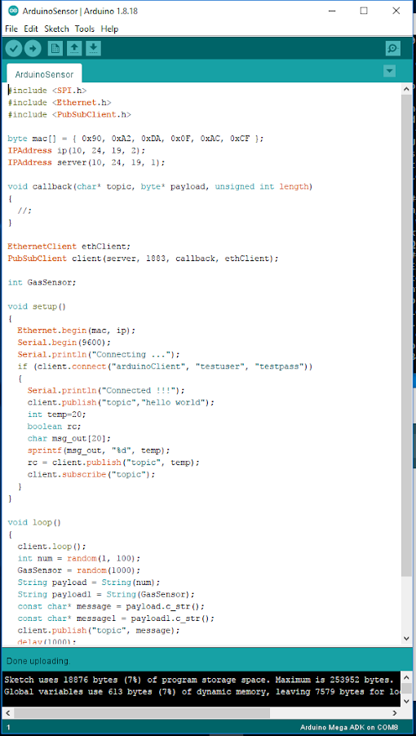
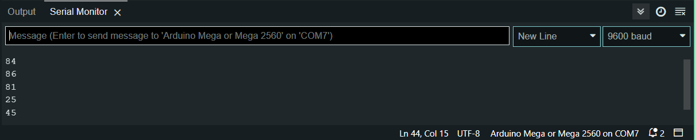
RESULTS
Manually setup Client in Arduino with Ethernet Shield Rev2

Slide 11
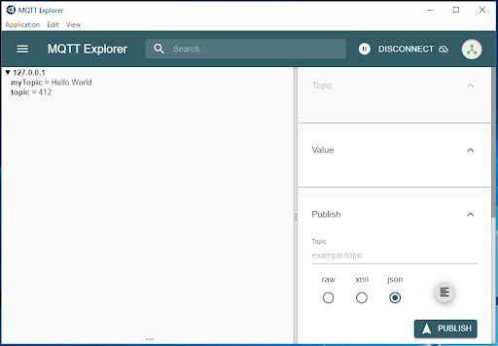
RESULTS
Testing using MQTT Explorer

Slide 12
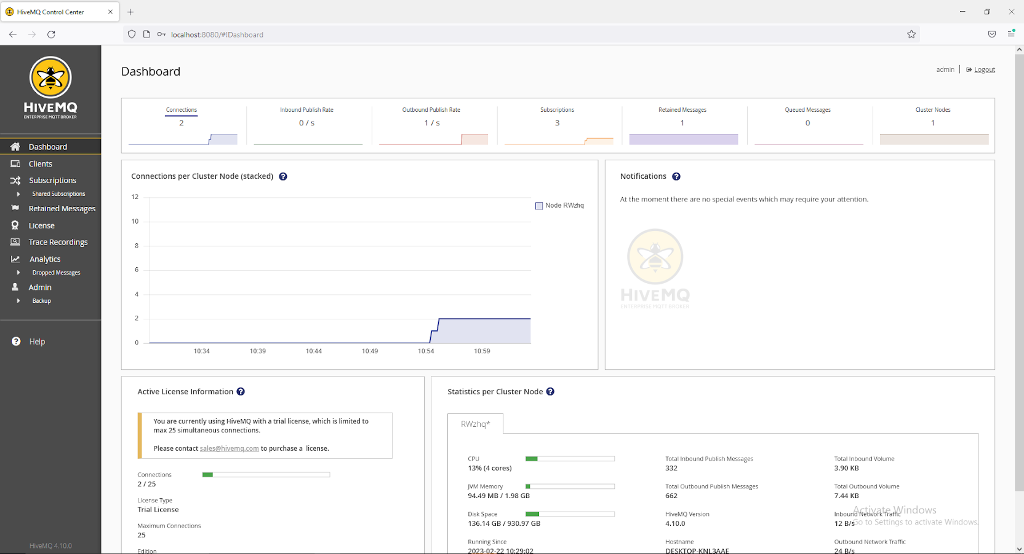
RESULTS
Dashboard of the HiveMQ giving details and status about the clients connected

Slide 13
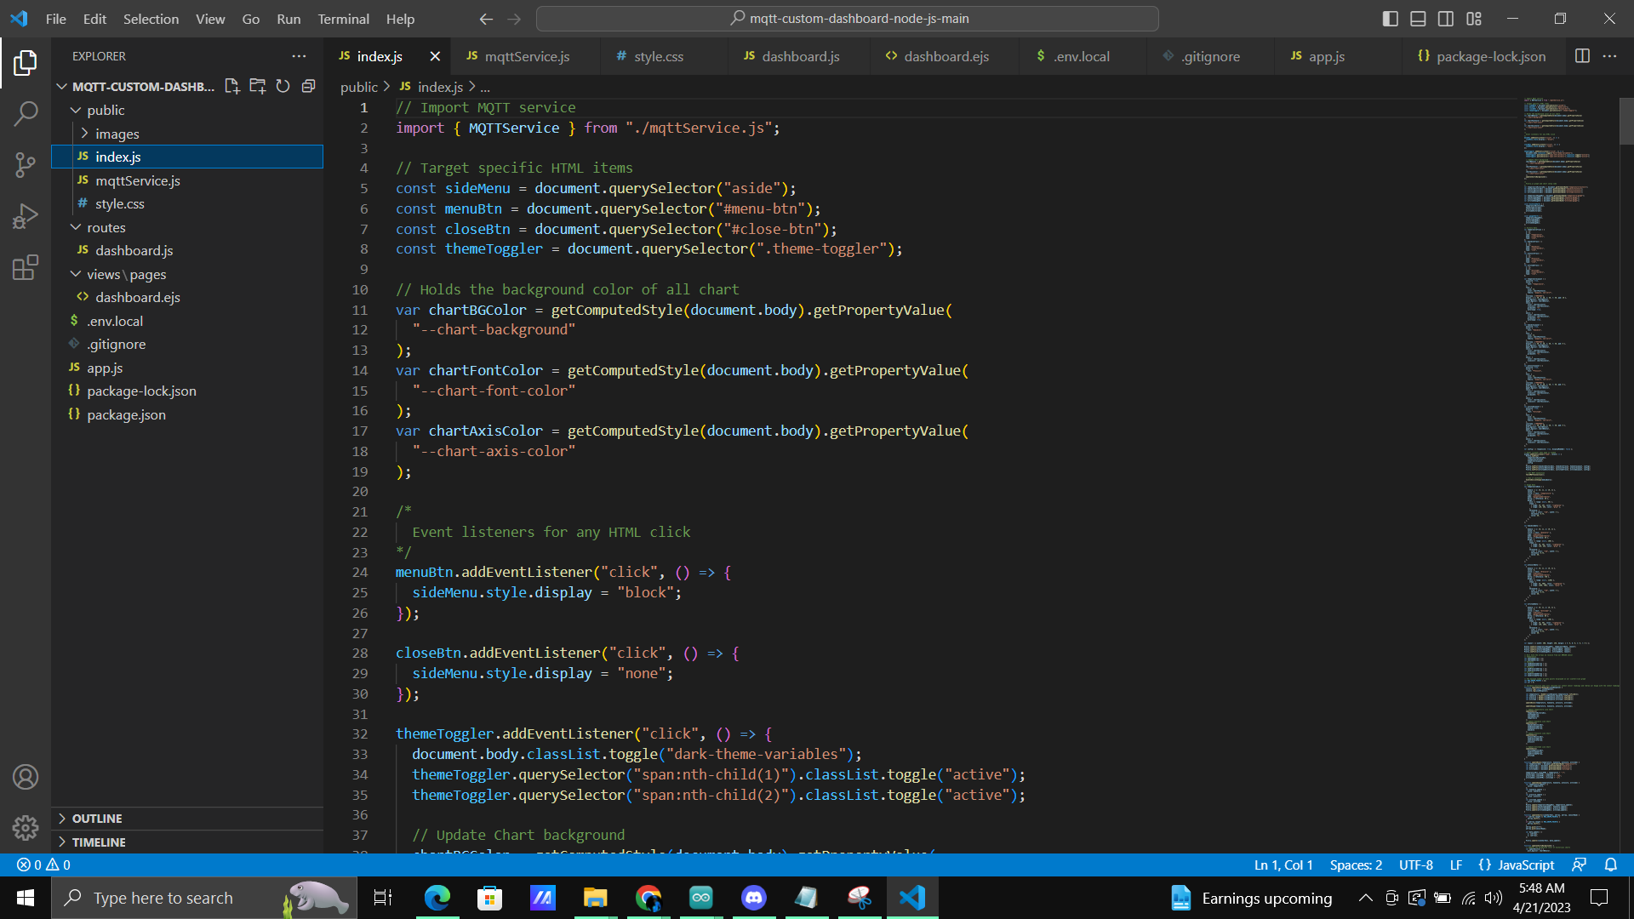
RESULTS
VS Code for the development of the Dashboard of the developed broker

Slide 14
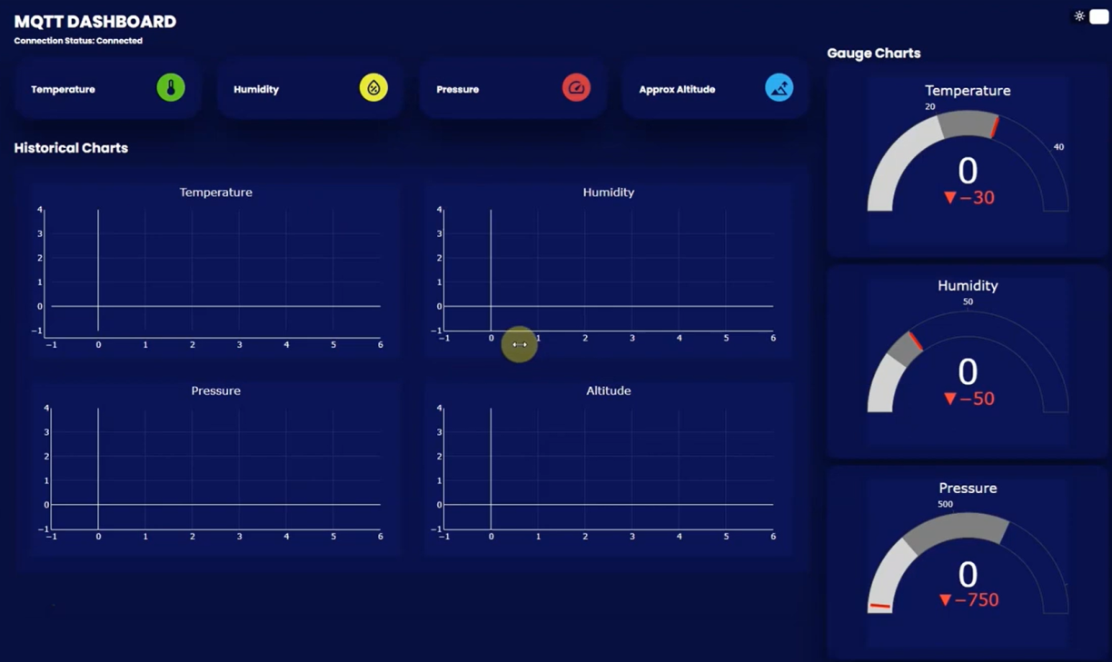
RESULTS
The graph when a new client is connected

Slide 15
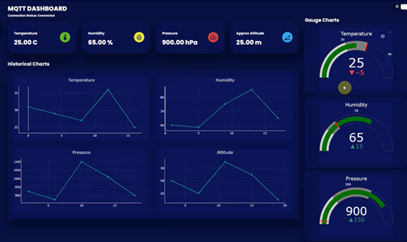
RESULTS
The graph is plotted based on the values published by the client

Slide 16
SCOPE FOR IMPROVEMENT
The proposed project is just the front view of the main application. Its performance can be optimized and improved by connecting it to the cloud, which can maximize the performance and the processing of the data retrieved from the power plant equipment.
Multiple clients support can be achieved
Login page can be added for security reasons

Slide 17
REFERENCE
https://www.hivemq.com/blog/mqtt-essentials-part-1-introducing-mqtt/
https://github.com/eclipse/mosquitto
https://www.qt.io/product/development-tools
https://embeddedlaboratory.blogspot.com/2023/01/getting-started-with-mqtt-using-qt.html
https://www.youtube.com/watch?v=DGB0GfFRqPo&t=307s
https://code.qt.io/cgit/qt/qtmqtt.git/

Slide 18


